Slide 1

CI/CD for Azure SQL in DevOps
Making it Easier
https://github.com/gwalkey

Slide 2

Overall Process
Develop your Database Project in Visual Studio and do initial checkin/commit
Create a Build Pipeline
Create a Release Pipeline
Enable the CI/CD Trigger
Enable Pre-Deployment Approvals
Verify your DB Changes
Setup the DevOps Dashboard Badges

Slide 3
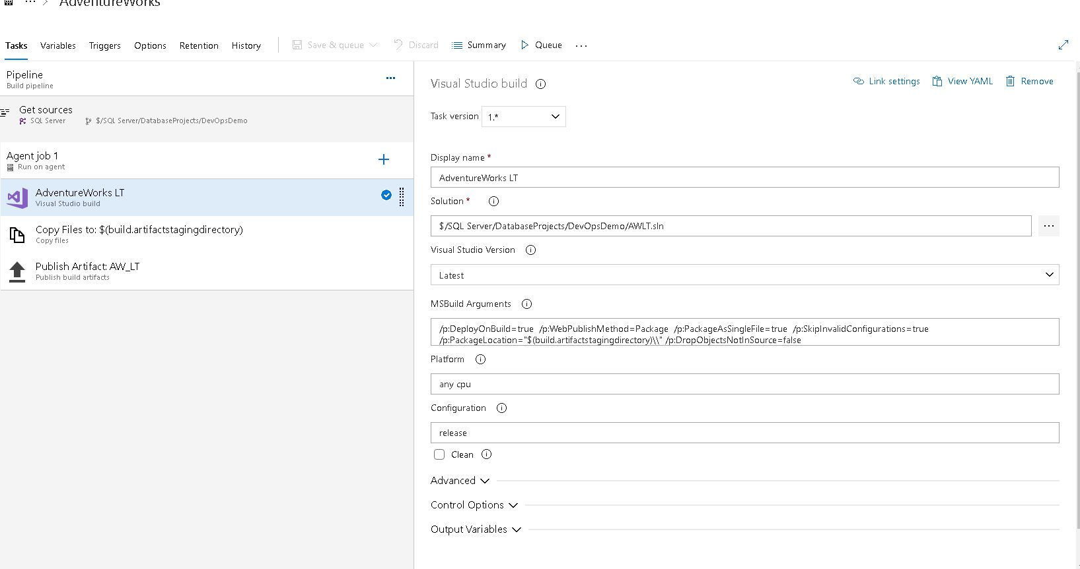
Creating a Build Pipeline
1
The Build Pipeline takes your source code and creates an artifact.
2
This requires that you store your code in a DevOps Repo. This Demo uses the TFVC Source Control provider.
3
Because this is a SQL instance, the build process simply runs SQLPACKAGE.EXE to create a DacPac as the artifact.
4
The DacPac becomes the input for the next step, the Release

Slide 4
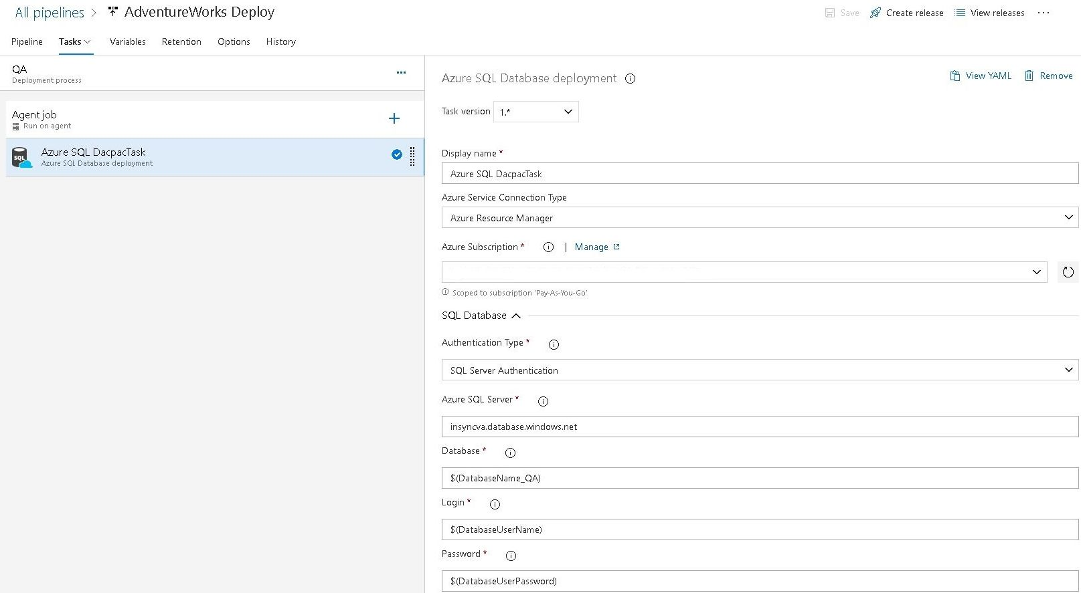
Creating a Release Pipeline
1
The Release Pipeline takes the DacPac and publishes it to an Azure SQL instance.
2
You can chain deployments to QA, DEV, Prod tiers on the same or separate SQL Servers
3
You can ask a Process Manager to Approve the Deployment
4
The system emails you and sets Project Dashboard build badges

Slide 5
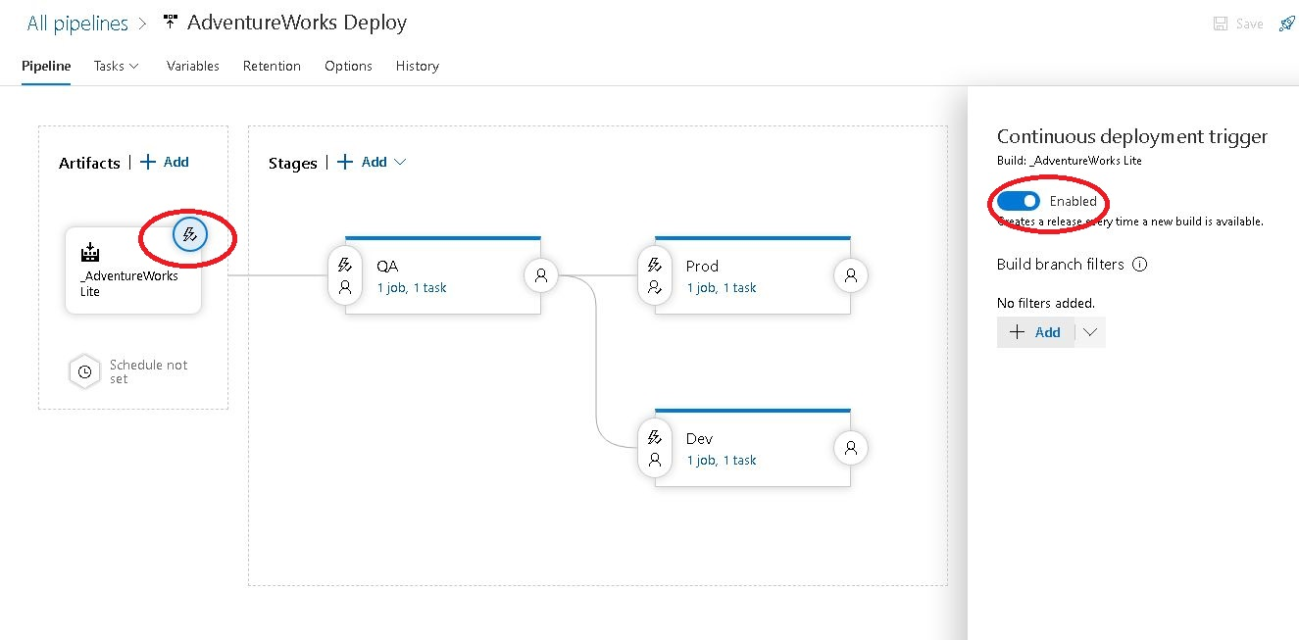
CI/CD Trigger
The Continuous Integration/Continuous Deployment trigger is found on the Artifact object in the Release Pipeline

Slide 6

More questions about CI/CD in Azure SQL?
Azure Pipeline Docs
https://github.com/gwalkey
Notes:
In Slide Show mode, select the arrows to visit links.

